Slide 1




KS4 Mathematics
S10 Cubes and Cuboids

Slide 2

Cubes and cuboids
A cuboid is a 3-D shape with edges of different lengths. All of its faces are rectangular or square.
Face
How many faces does a cuboid have?
6
How many edges does a cuboid have?
12
How many vertices does a cuboid have?
Edge
Vertex
8
A cube is a special type of cuboid with edges of equal length. All of its faces are square.

Slide 3
Length around the edges
Suppose we have a cuboid of length 5 cm, width 4 cm and height 3 cm. What is the total length around the edges?
Imagine the cuboid as a hollow wire frame:
The cuboid has 12 edges.
3 cm
4 edges are 5 cm long.
4 edges are 4 cm long.
4 cm
4 edges are 3 cm long.
5 cm
Total length around the edges = 4 × 5 + 4 × 4 + 4 × 3
= 20 + 16 + 12
= 48 cm
Notes:
Explain that although we are measuring around the edges of a three-dimensional shape, the answer only has one dimension. We therefore express it in centimetres.

Slide 4
Length around the edges
To find the length around the edges of a cuboid of length l, width w and height h we can use the formula:
Length around the edges = 4l + 4w + 4h
or
Length around the edges = 4(l + w + h)
To find the length around the edges of a cube of length l we can use the formula:
Length around the edges = 12l
Notes:
Ask pupils to explain how the formula for the length around the edges of a cube is derived.

Slide 5
Surface area of a cuboid
To find the surface area of a cuboid, we calculate the total area of all of the faces.
A cuboid has 6 faces.
The top and the bottom of the cuboid have the same area.
Notes:
Discuss the meaning of surface area. The important thing to remember is that although surface area is found for three-dimensional shapes, surface area only has two dimensions. It is therefore measured in square units.

Slide 6
Surface area of a cuboid
To find the surface area of a cuboid, we calculate the total area of all of the faces.
A cuboid has 6 faces.
The front and the back of the cuboid have the same area.

Slide 7
Surface area of a cuboid
To find the surface area of a cuboid, we calculate the total area of all of the faces.
A cuboid has 6 faces.
The left hand side and the right hand side of the cuboid have the same area.

Slide 8
Formula for the surface area of a cuboid
We can find the formula for the surface area of a cuboid as follows.
Surface area of a cuboid =
w
l
2 × lw
Top and bottom
h
+ 2 × hw
Front and back
+ 2 × lh
Left and right side
Surface area of a cuboid = 2lw + 2hw + 2lh
Notes:
Pupils should write this formula down.

Slide 9
Surface area of a cube
How can we find the surface area of a cube of length l?
All six faces of a cube have the same area.
The area of each face is l × l = l²
Therefore,
l
Surface area of a cube = 6l²
Notes:
As pupils to use this formula to find the surface area of a cube of side length 5 cm.
6 × 5² = 6 × 25 = 150 cm².
Repeat for other numbers.
As a more challenging question tell pupils that a cube has a surface area of 96 cm². Ask them how we could work out its side length using inverse operations.

Slide 10
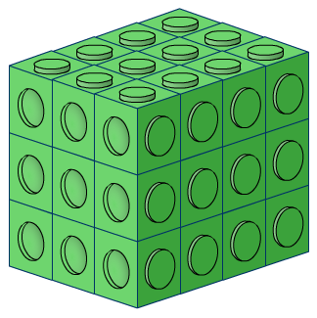
Volume of a cuboid
The following cuboid is made out of interlocking cubes.
How many cubes does it contain?

Slide 11
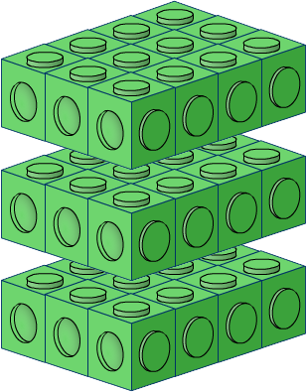
Volume of a cuboid
We can work this out by dividing the cuboid into layers.
The number of cubes in each layer can be found by multiplying the number of cubes along the length by the number of cubes along the width.
3 × 4 = 12 cubes in each layer
There are three layers altogether so the total number of cubes in the cuboid = 3 × 12 = 36 cubes

Slide 12
Volume of a cuboid
We can find the volume of a cuboid by multiplying the area of the base by the height.
The area of the base
= length × width
So,
height, h
Volume of a cuboid
= length × width × height
= lwh
length, l
width, w
Notes:
We can also think of the volume of a cuboid as a measure of the number of cm³ that will fit inside it.
Remind pupils that a cuboid is a special type of prism. Ask pupils if they can remember the formula for the volume of a prism and compare it to the formula on the board. This is covered in the next section of this presentation, but some pupils will remember it from earlier years.

Slide 13
Volume of a cube
How can we find the volume of a cube of length l?
The length, width and height of a cube are the same.
Therefore:
Volume of a cube
= (length of one edge)³
= l³
l

Slide 14
Volume of shapes made from cuboids
What is the volume of this 3-D shape?
3 cm
We can think of this shape as two cuboids joined together.
3 cm
4 cm
Volume of the green cuboid
= 6 × 3 × 3 = 54 cm³
6 cm
Volume of the blue cuboid
= 3 × 2 × 2 = 12 cm³
Total volume
5 cm
= 54 + 12 = 66 cm³
Notes:
This shape is an L-shaped prism so we could also find the volume of this shape by multiplying the area of its cross-section by its length.

